Slide 1
Scraping Anime Data from MyAnimeList Website
By: Erfia Nadia Safari

Slide 2
The Steps:
01
02
Scraping Data
Cleaning Data
03
04
Export to Excel
Data Visualization

Slide 3
01
Scraping Data

Slide 4
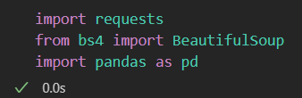
Import Library

Slide 5
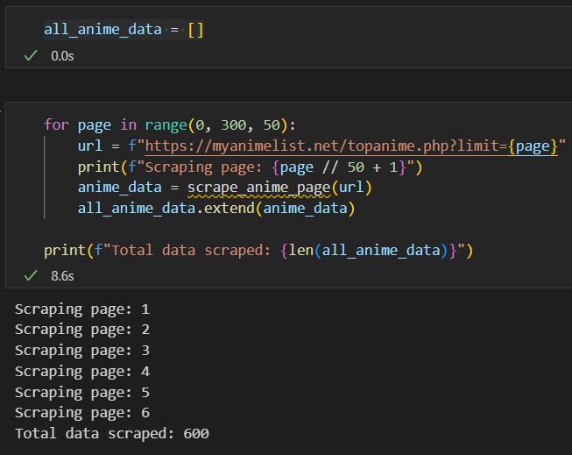
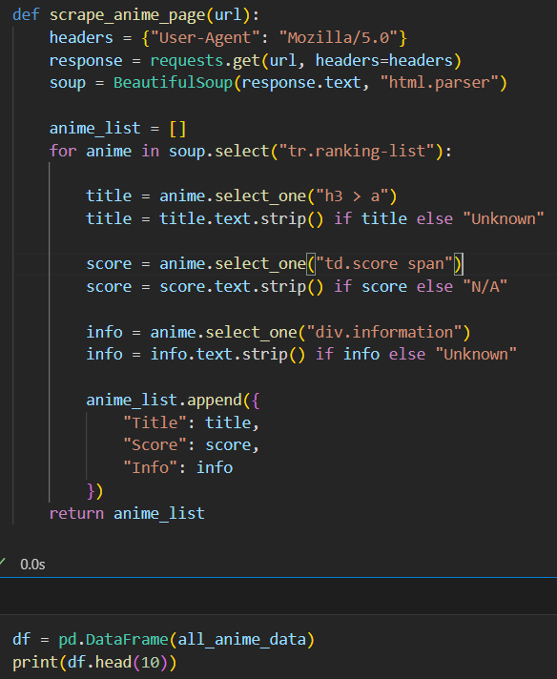
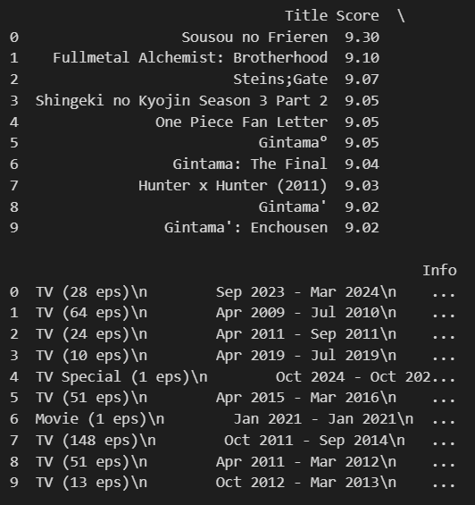
Scraping Data
Using for loop to scrape data that has many pages
Output:

Slide 6
02
Cleansing Data

Slide 7
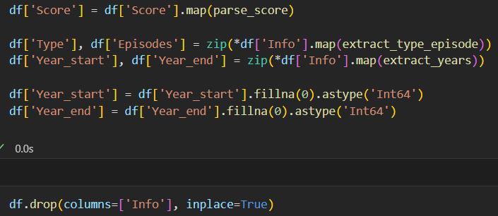
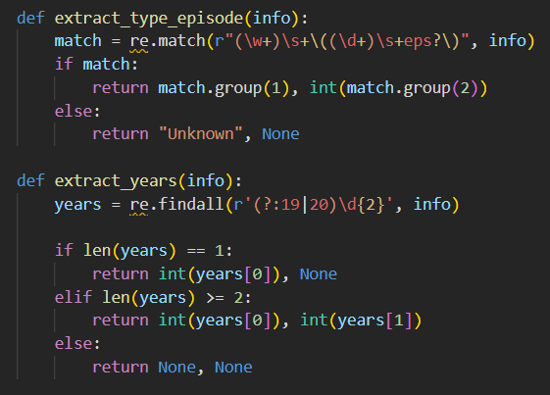
Cleaning Data
1. Extraction of type, number of episodes and year of release
2. Find missing values

Slide 8

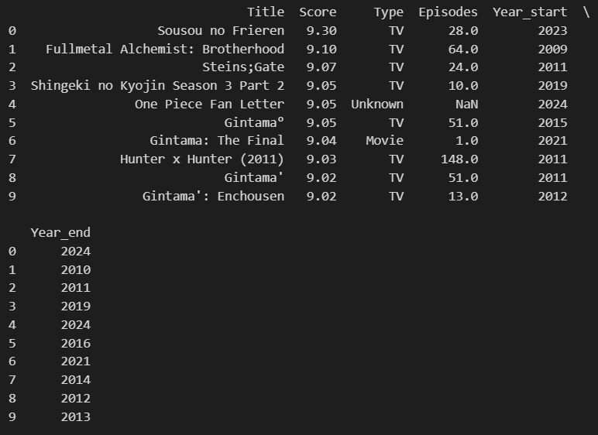
Output: shows 10 columns starting from title, score, episodes, release year and end year

Slide 9
03
Export to Excel

Slide 10
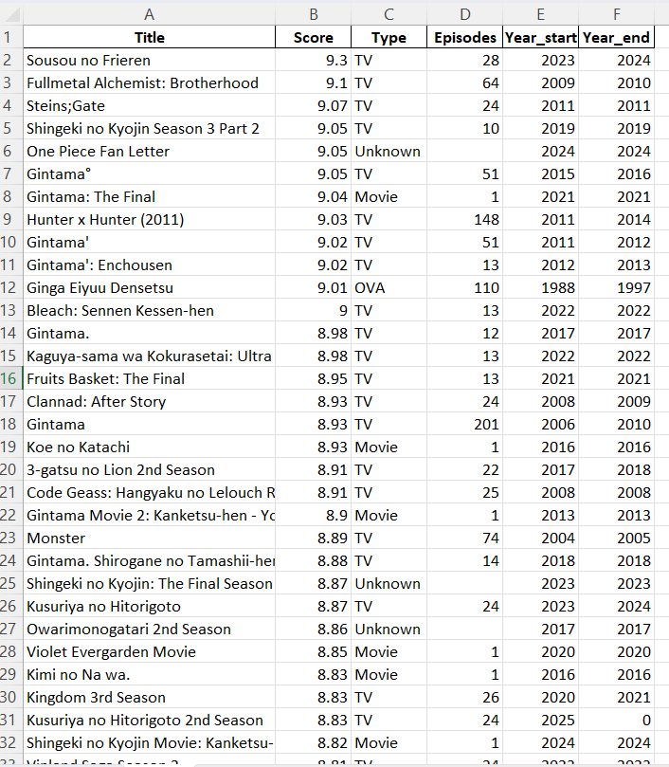
Extract to Excel
Output:

Slide 11
04
Analysis and Visualization Data

Slide 12
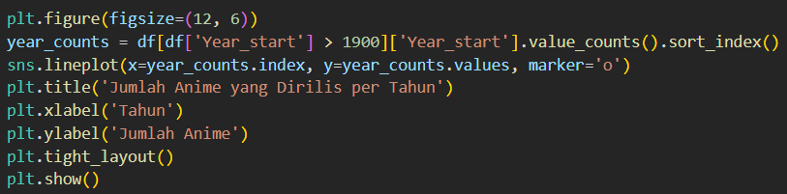
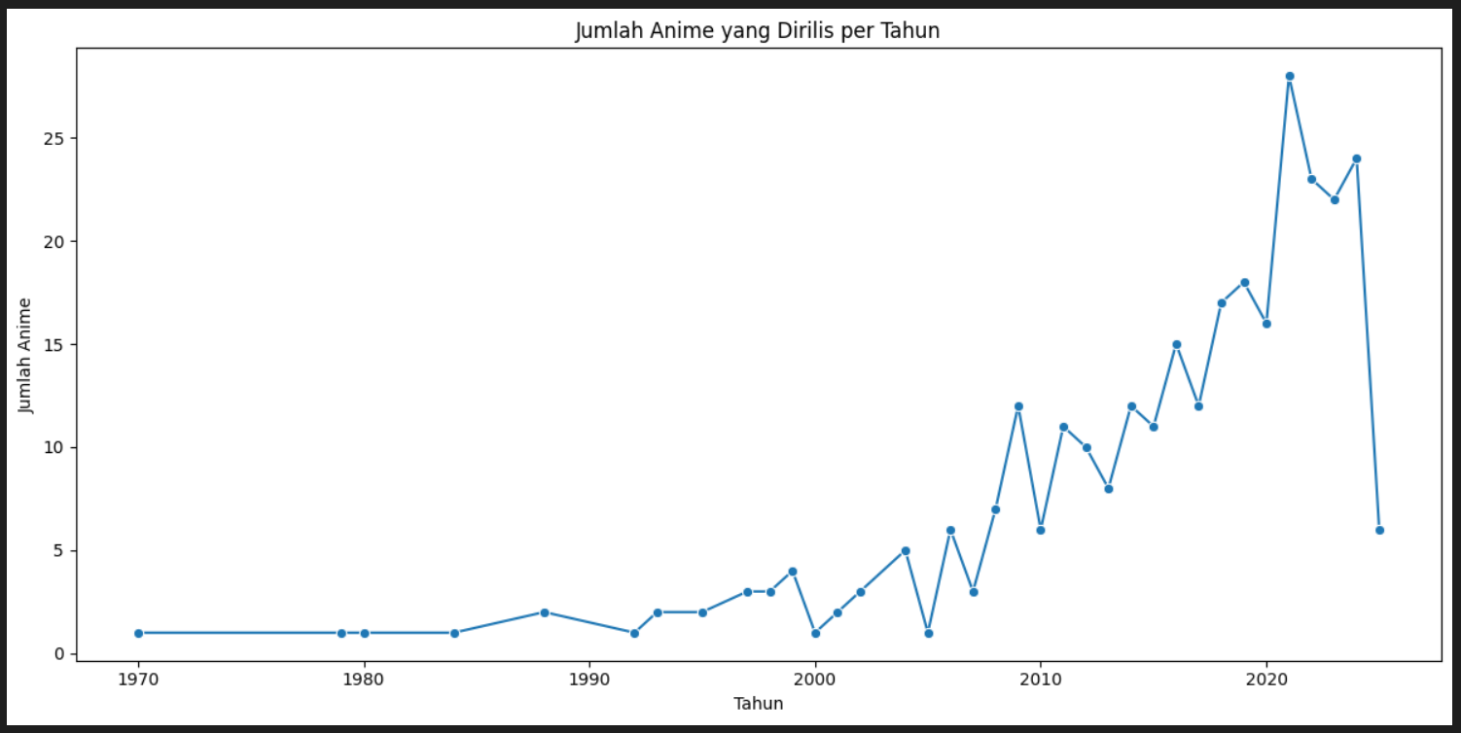
1. NUMBER OF ANIME RELEASED PER YEAR
To shows the number of anime released each year, to see the development trends of the anime industry over time.
Since the first anime appeared in 1970, anime production has continued to increase and peaked after 2020, when the COVID-19 pandemic took place. This shows that the number of anime viewers increased during the pandemic.

Slide 13
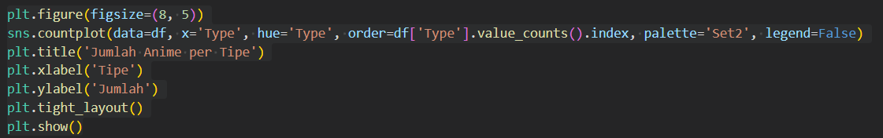
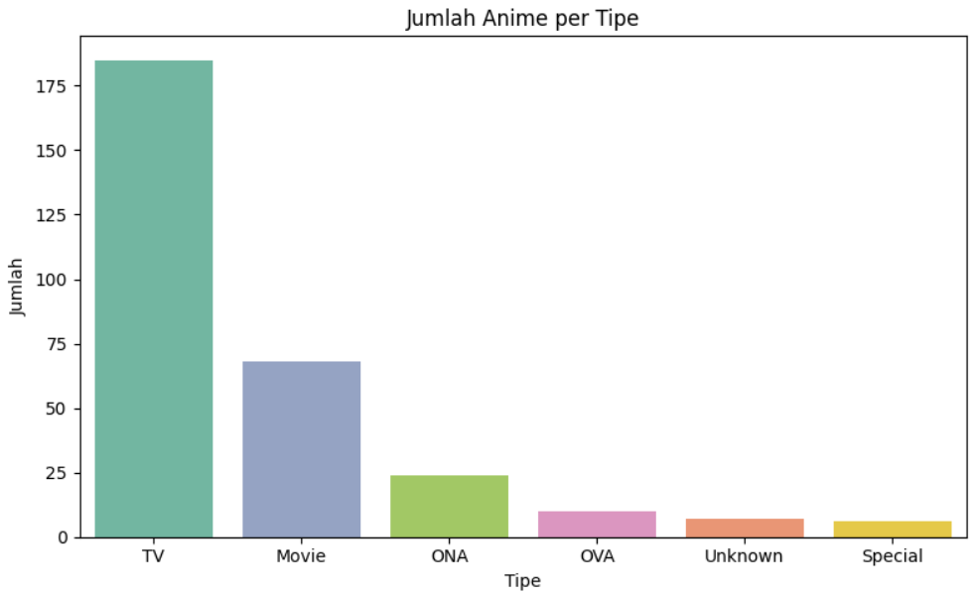
2. Number of Anime per Type
To shows the distribution of the number of anime by type (TV, Movie, OVA, etc.) to understand the composition of anime types included in the MyAnimeList Top Anime list.
That can be conclude:
Most of the anime on the list are TV series.
Movies, OVAs, and Specials are generally much less than TV.

Slide 14
THANK YOU!

